Slide 1
MOVIE RATINGS
Khushi Srivastava

Slide 2
Project Brief
You have been approached as an analytics consultant by a movie reviews website.
They are writing up an article analysing movie ratings by critics and audience as well as movie budgets for the years 2007-2011.
This is the first time they are doing this analysis and they don’t know exactly what they need. They have asked you to look into the data and provide them with 5 graphs that tell a story about the data.
However, there is one chart the CEO specifically requested - a diagram showing how the correlation between audience and critic ratings has evolved throughout the years by genre. This is in addition to the other 5.

Slide 3
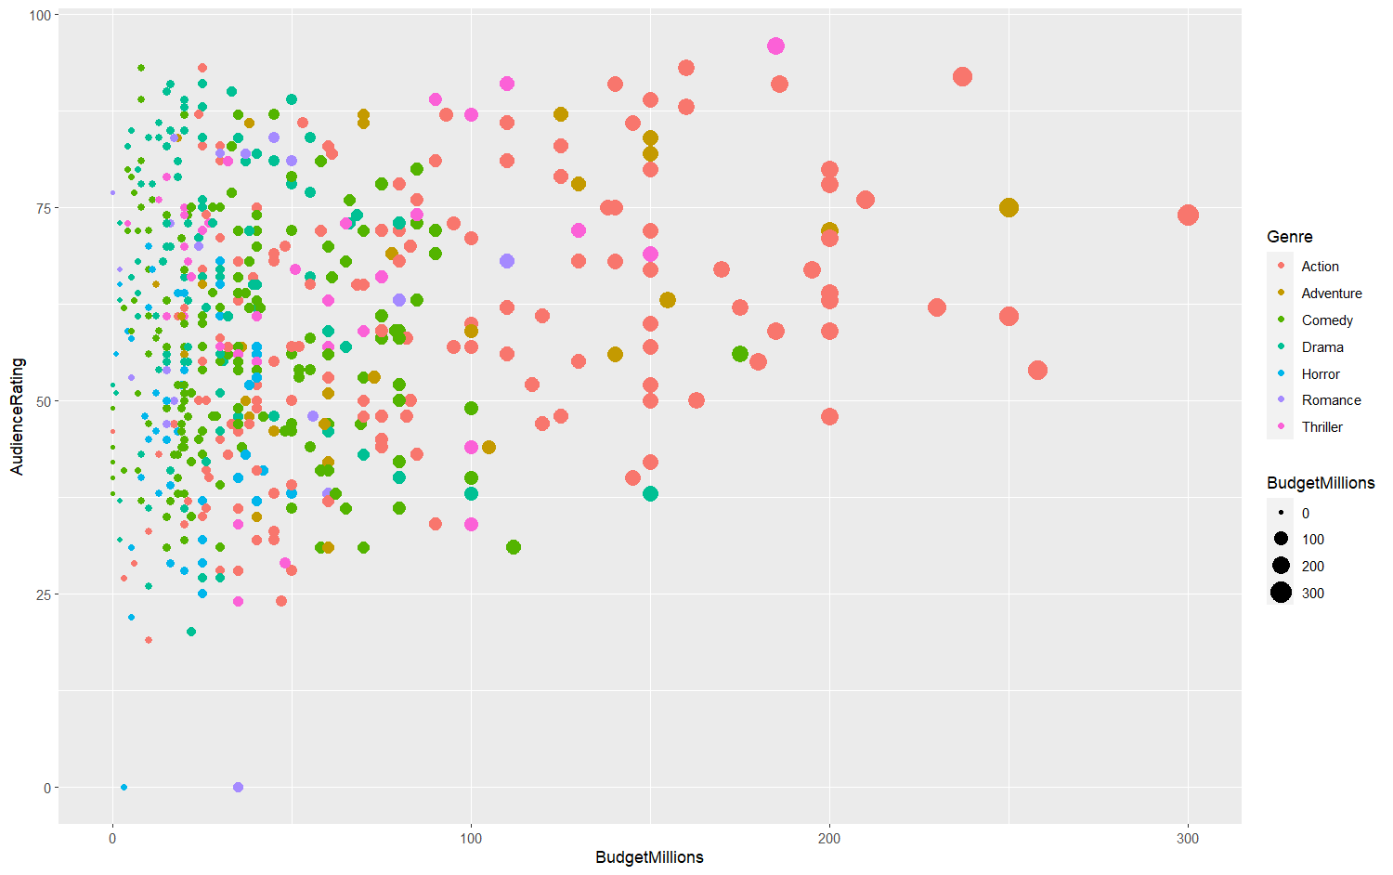
Scatterplot : Audience rating vs Budget (in millions) grouped by Genre

Slide 4
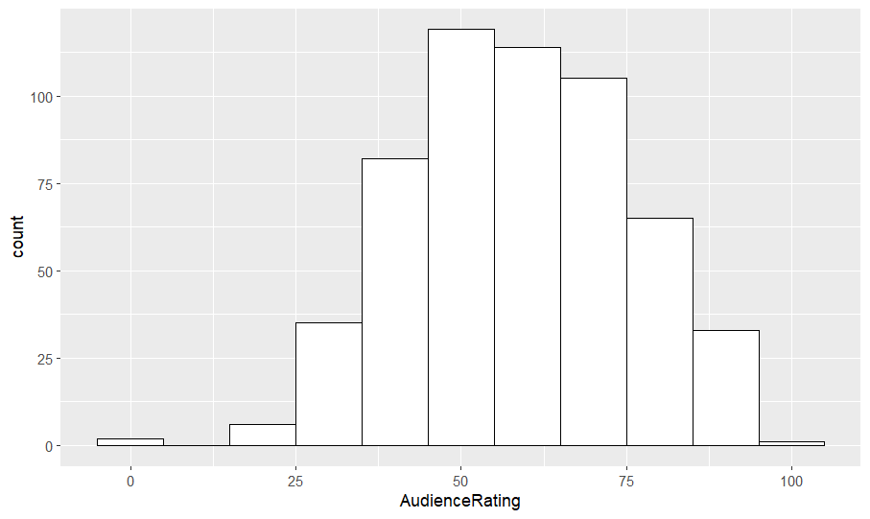
Histogram : Audience Rating

Slide 5
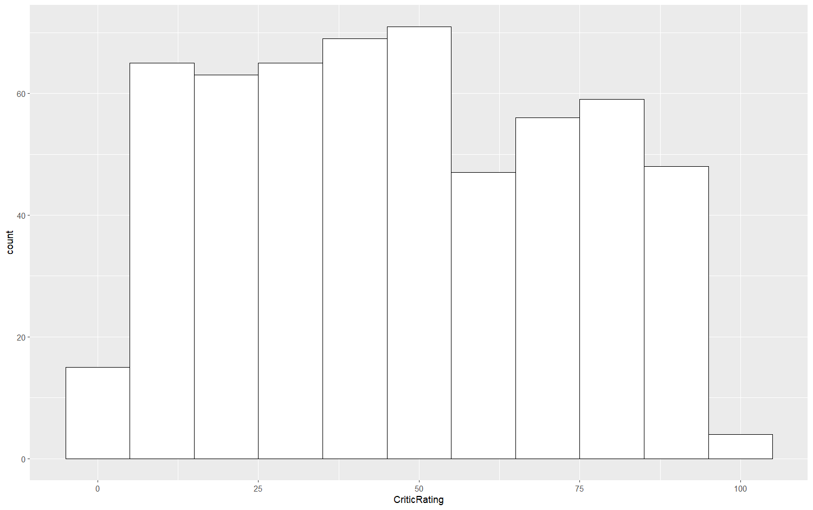
Histogram : Critic Rating

Slide 6
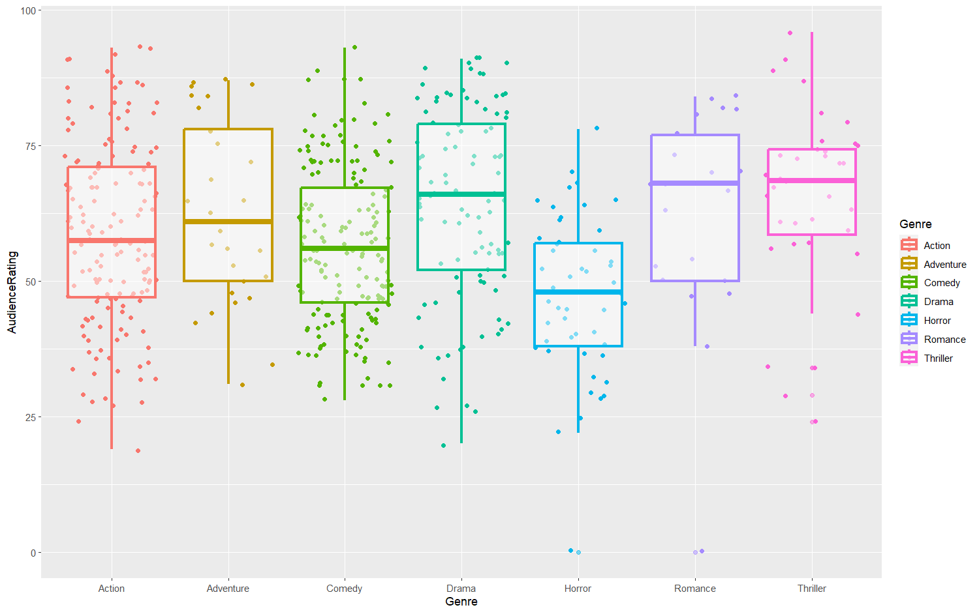
Boxplot : Audience Rating of different Genre

Slide 7
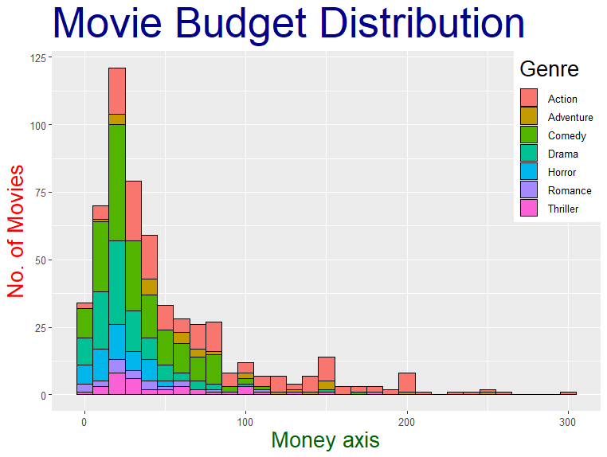

Slide 8
FACET GRID
Correlation between Audience & Critic Ratings: evolution throughout the years by Genre

Slide 9
